Slide 1



INNOVAZIONE NELLE RETI DI ACCESSO
A BANDA ULTRALARGA
Architettura Layer 2
e nuove sfide operative
Franco Grisolia
Eurekalabria 2026 | 24 settembre 2026

Slide 2






The evolution of the FWA offering
LAYER 2 IS THE OUTCOME OF A BROADER EVOLUTION ACROSS NETWORK, SYSTEMS AND THE WHOLESALE OFFERING
EXANDED
NETWORK REACH
WINDTRE TECHNOLOGY AND SYSTEMS INTEGRATION
FWA LAYER L3
FWA LAYER L2
FOUNDATIONAL ENABLERS
FWA OFFERING EVOLUTION
Extended network coverage and mobile access for wholesale services.
Integration into the Group’s technology and operational architecture.
Launch of the wholesale FWA Layer 3 offering, with IP-level service delivery.
A new Layer 2 access model providing operators with greater control, flexibility and network integration.
2025
2026
YE26

Slide 3
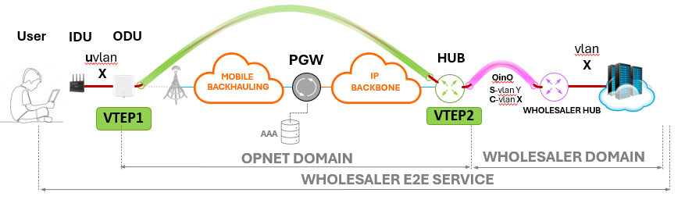
Architectural Technical Choice
OVN: OVERLAY VIRTUAL NETWORKING
Layer 2 transport of traffic aggregated over the FWA access is enabled through a VxLAN tunnel established between the Outdoor Unit (ODU), supplied by OPNET, and the HUB node connected to the wholesale customer.
Based on the number of user VLANs configured at the customer site, each of the two tunnel endpoints
(VTEPs, VxLAN Tunnel EndPoint) may be associated with one to three VNIs.
The solution is highly scalable, allows to manage up to 16 million VLANs.

Slide 4
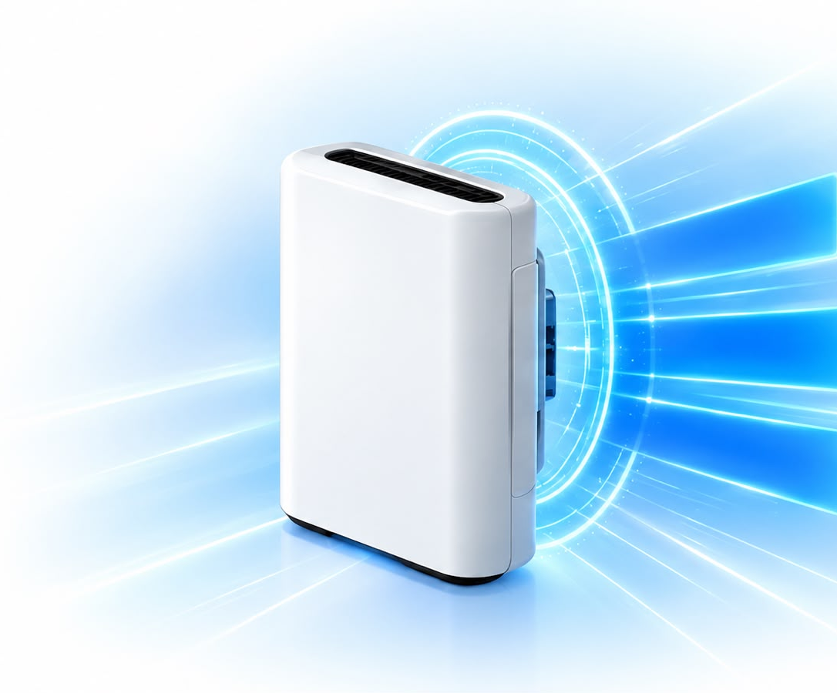



Challenges faced
IT'S "ONLY" AN ODU
ODU New Feature VxLAN
New Chipset
New
VLAN
TAG
Easy
config
QoS
4

Slide 5

Challenges faced
VXLAN (VIRTUAL EXTENSIBLE LAN, RFC 7348)
MAC Header
IP Header
UDP Header
VXLAN Header
Original Layer 2 Frame
FCS
Destination MAC
Source MAC
VLAN Type
VLAN ID TAG
EtherType
IP Heasr Misc Data
Protocol 0x11
Header Checksum
Outer Source IP
Outer Destination IP
UDP source port
VXLAN Destination Port
UDP Length
UDP Checksum
VXLAN Flags
Reserved
VNID
Reserved
MAC | IP | TCP/UDP | Payload
18 Bytes
20 Bytes
8 Bytes
8 Bytes
1500 Bytes
54 Bytes of Overhead (realistic)

Slide 6






Challenges faced
MTU
CORE Mobile
MTU
RAN
(Radio Access Network)
ODU
S-GW
Mobile
BackHauling
P-GW
FWA
MTU
MTU
VTEP
SecGW
MTU
WHOLESALER
BB IP
USER
E-NNI
e/g Node-B
MTU
MTU
VTEP
IDU
MTU
MTU
VTEP
on ODU
VxLAN Tunnel
VTEP
on E-NNI
6

Slide 7

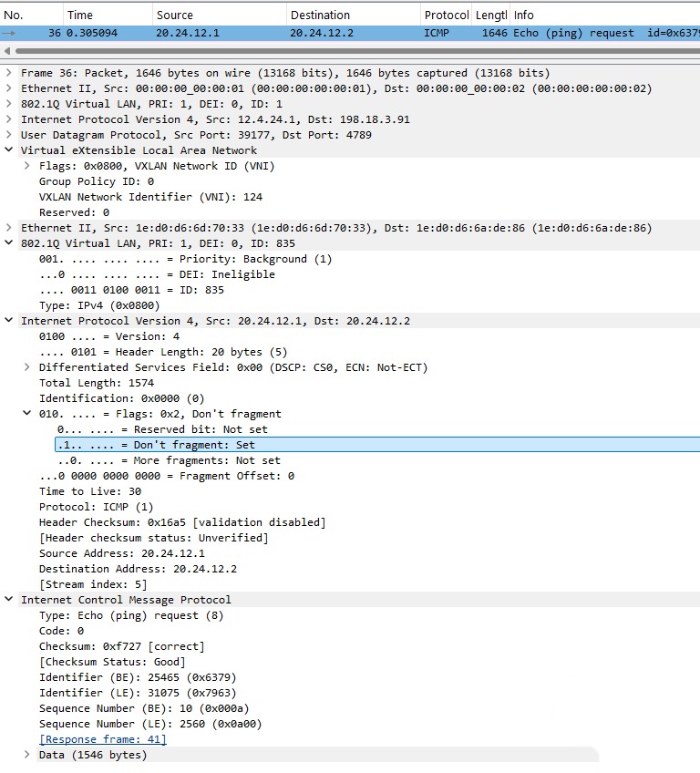


Challenges faced
TESTING MTU
MTU GROWS
1646
MTU
USER
ODU
MTU
1646 byte
1546 byte
IDU
1574
MTU
1574 byte
Data Payload 1546 byte
Don't Fragment
1546

Slide 8
Use cases
Option #1
Option #2
Option #3
Mono VLAN
Multi Cos 0,1,5
Multi VLAN
Mono Cos [0]-[1]-[5]
Mono VLAN
UnTAG
VLAN 835 [0]
VLAN 835
(0,1,5)
UNTAG
VLAN 935 [1]
VLAN 837 [5]
IDU
ODU
IDU
ODU
IDU
ODU
S-Vlan/C-Vlan
3x(S-Vlan/C-Vlan)
S-Vlan/C-Vlan
9

Slide 9
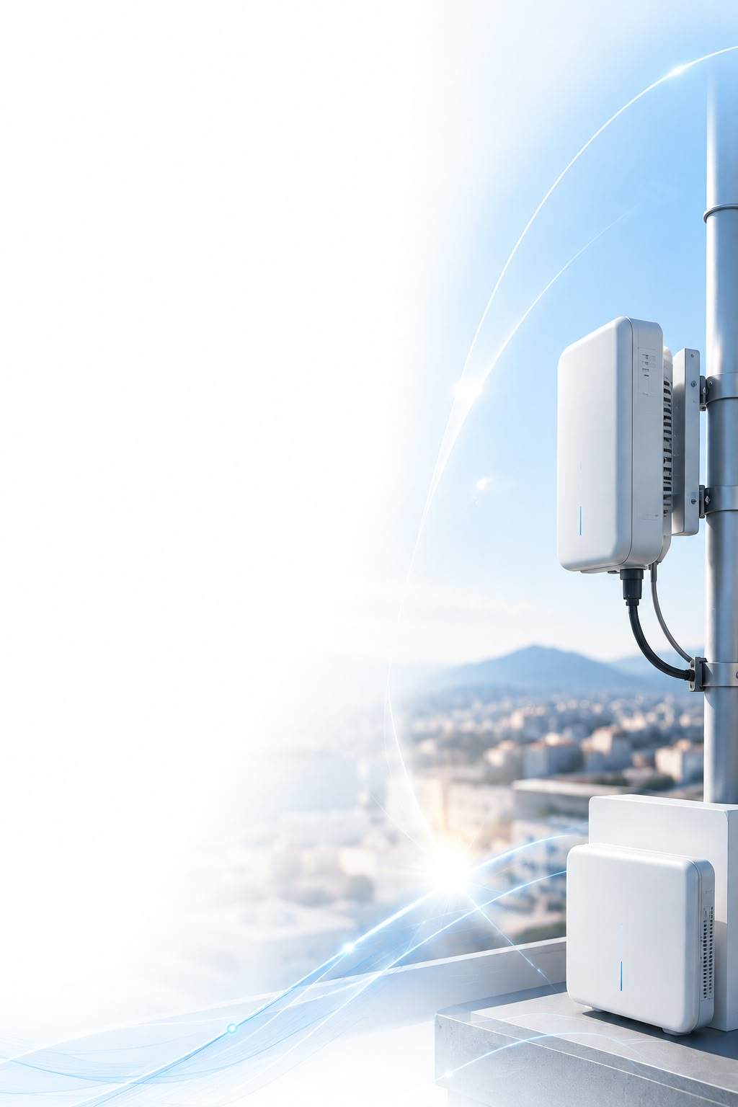
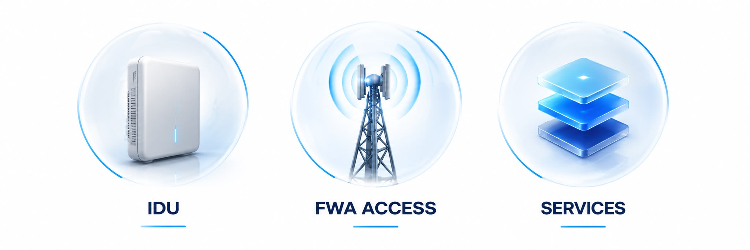
Conclusions
KEY TAKEAWAYS FOR FWA L2 WHOLESALE
InDoor Unit (IDU) provided and managed by the Wholesale Customer; caratteristics:
"IEEE 802.1q" and "IEEE 802.1p" standards
Maximum MTU 1574 Bytes (at IP level)
End-user services provided by the Wholesale Customer (IP address, Voice service,...)
OuDoor unit (ODU) termination of L2 Tunnel provided and managed by OPNET
  FWA Access traffic uniquely identified via an S-VLAN/C-VLAN pair
  An external tag (S-VLAN)
  An internal tag (C-VLAN) that identifies the FWA Wholesale access of a specific property unit
  Traffic delivered via E-NNI interconnection
  IEEE 802.1q (vlan tagging), IEEE 802.1ad (QinQ), 802.3ad (LACP)
  MTU set to 9000 Bytes
  POP available RM Tor Cervara W3 and MI Ortles W3; RM NAMEX and MI Caldera will be added soon
  3 Service Scenarios currently envisaged:
  MONO-COS tagged= up to 3 user VLANs (User-VLAN 835, 837 and 935) with different COS (0, 1 or 5 respectively)
  MULTI-COS tagged= a unique uvlan (User-VLAN 835) multicolor (COS 0, 1, 5)
  MONO-COS Untagged= a single untagged VLAN (best effort)
10

Slide 10
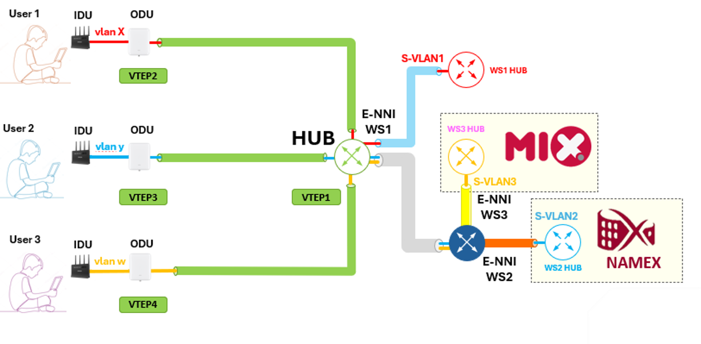
FWA L2 Architecture

Slide 11

Thank you
OpNet S.r.l.
Sede Legale Via Monte Rosa 91, 20149 Milano (MI))
www.opnet.it

